Slide 1
Torrey Pines HOA
2025 Annual Meeting

Slide 2
Agenda
Roll Call / Quorum report
Notice of Annual Meeting
2024 Minutes
Reports of Officers
Report of Board of Directors
Election of Officers
Unfinished Business
New Business
Adjourn

Slide 3
Introductions
Board Members
Michael Classen
John Gocken
Jen Johnson
Christy Kofoed
Bryan Stavneak
Sage HOA Services

Slide 4
Purpose of the HOA
Homeowners Associations are designed to manage common or shared property, protect owners' property values, provide services to residents, and develop a sense of community through social activities and amenities.
Torrey Pines HOA maintains the entrances in the entrance of the HOA as well as the medians

Slide 5
Officer Reports
HOA President
2024 in review
Items for 2025
Treasurer
HOA Budget

Slide 6
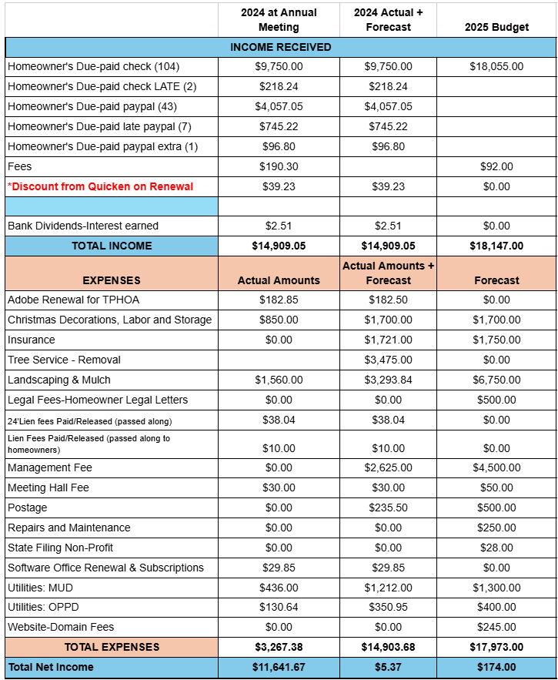
2025 Budget

Slide 7
Board Of Directors Report
HOA is in good standing
Reminder of Torrey Pines Fining standards per Article 3, Section 3(b) of the by-laws

Slide 8

HOA Board Position

Slide 9
Unfinished Business

Slide 10
New Business
If you have new business please bring it up at this time

Slide 11
Thank you
Any questions please feel free to contact us at
Torreypineshoa@sagehoaservices.com
402-249-4003

